Slide 1
Traffic Board Sign Detector
TEAM 3
Naga Surendra Bethapudi
Kesava Sai Krishna Puligadda
Sai Krishna Yarraguntla

Slide 2
Project Purpose
To develop a responsive model that allows to vehicles to detect the traffic boards accurately.
This model can be linked to vehicle software.

Slide 3
Acquire Data
Acquire the Data
Explore the data(Images)
Read the Video
Remove unwanted data
Cut the video into frames and selected top images which has high probability.
Build a Model(CNN)
Train & Validate
GUI with Keras
Process the Images
Predict the sign Board
Predict the sign Board

Slide 4
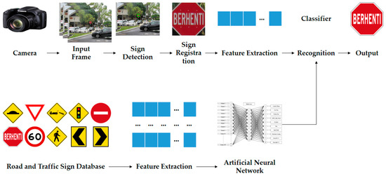
Model

Slide 5
Progress in the project
We want to do the project in two parts:
1. Predicting the sign boards from images
2. Predicting the sign boards in videos.
So far we have completed the first part, i.e predicting the sign boards from images
We will continue our work on the other part too.

Slide 6
Steps followed in the code
Importing the libraries and data.
Overlook into data.
Building a CNN model and finding the accuracy.
Accuracy and loss plots over train and test data
Saving the model.
Building a GUI by using above sequential model
Creating tkinter:
Design
Prediction function
Display prediction
Upload an Image

Slide 7
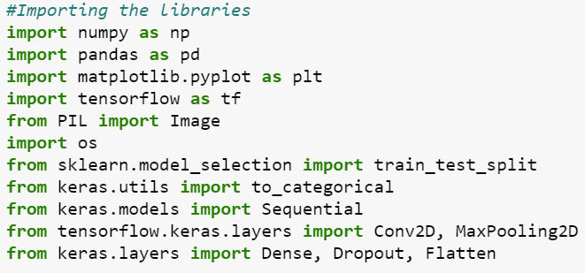
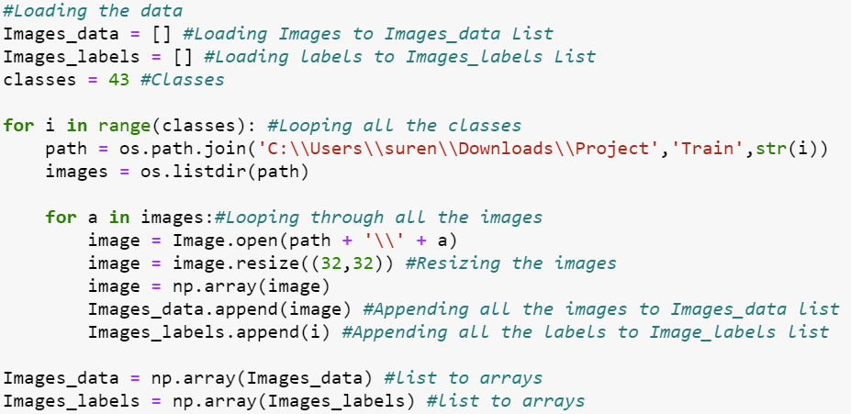
1. Importing the libraries and data.

Slide 8
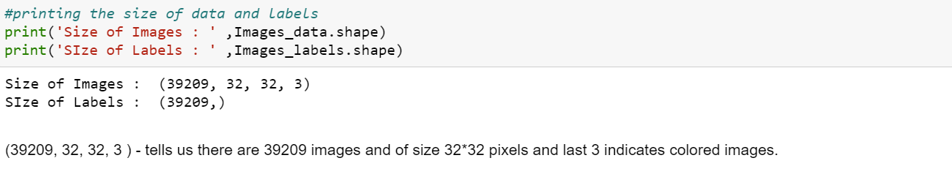
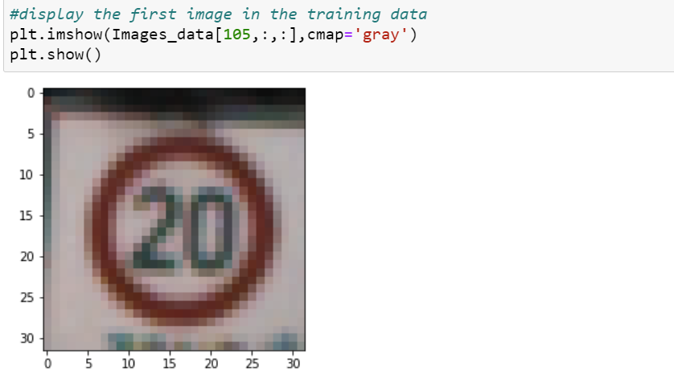
2. Overlook into data.

Slide 9
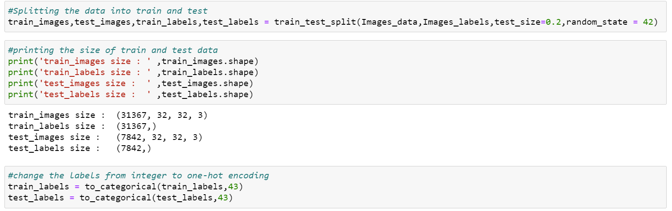
2. Overlook into data.

Slide 10
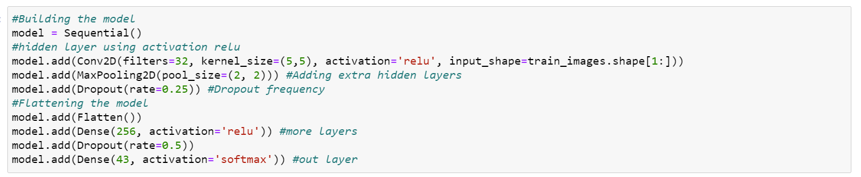
3. Building a CNN model and finding the accuracy.
Built the sequential model using Conv2D, Maxpooling2D and used activation as relu, softmax.
Included Dropout rate.

Slide 11
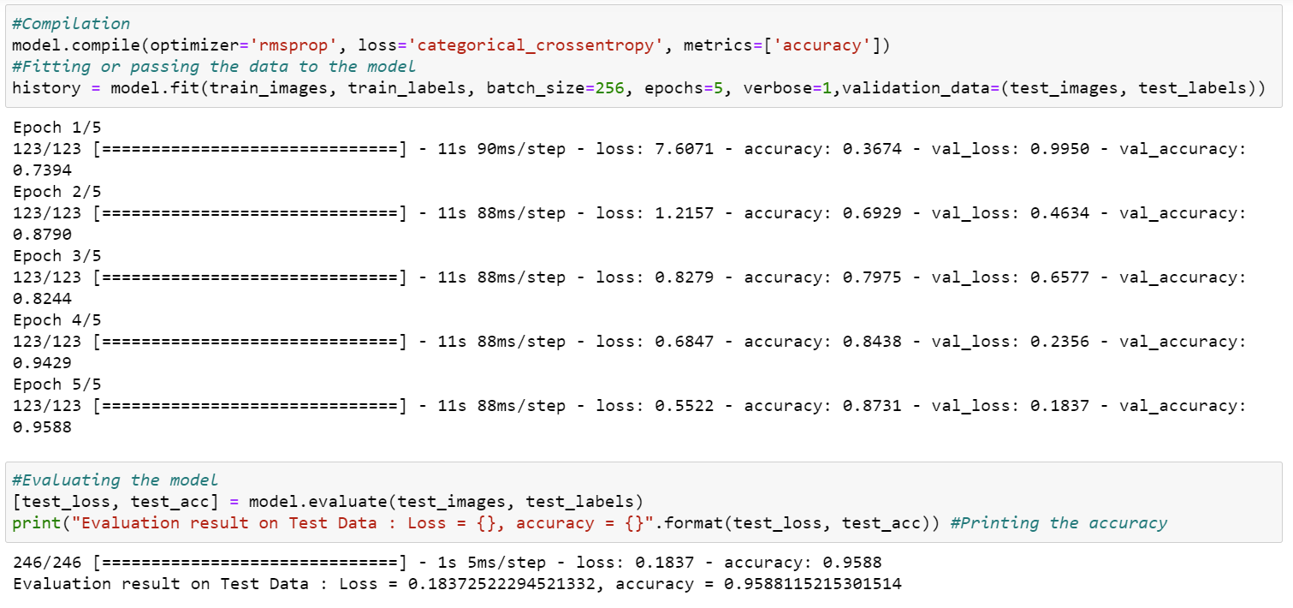
3. Building a CNN model and finding the accuracy.
Model got accuracy of 95% and loss of 18%

Slide 12
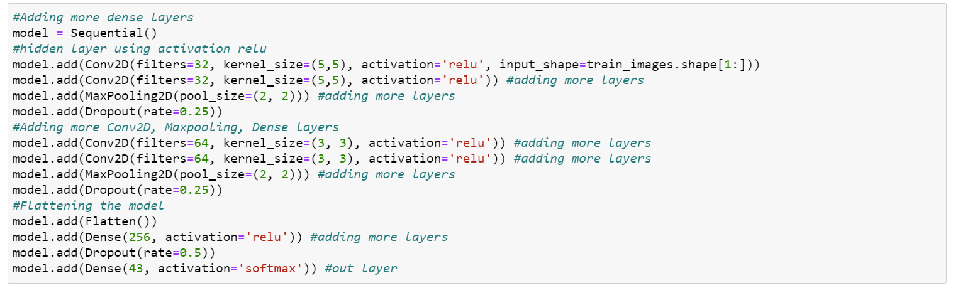
3. Building a CNN model and finding the accuracy.
However we got an good accuracy and loss, will try to add more dense layers and will see the model accuracy and loss again.

Slide 13
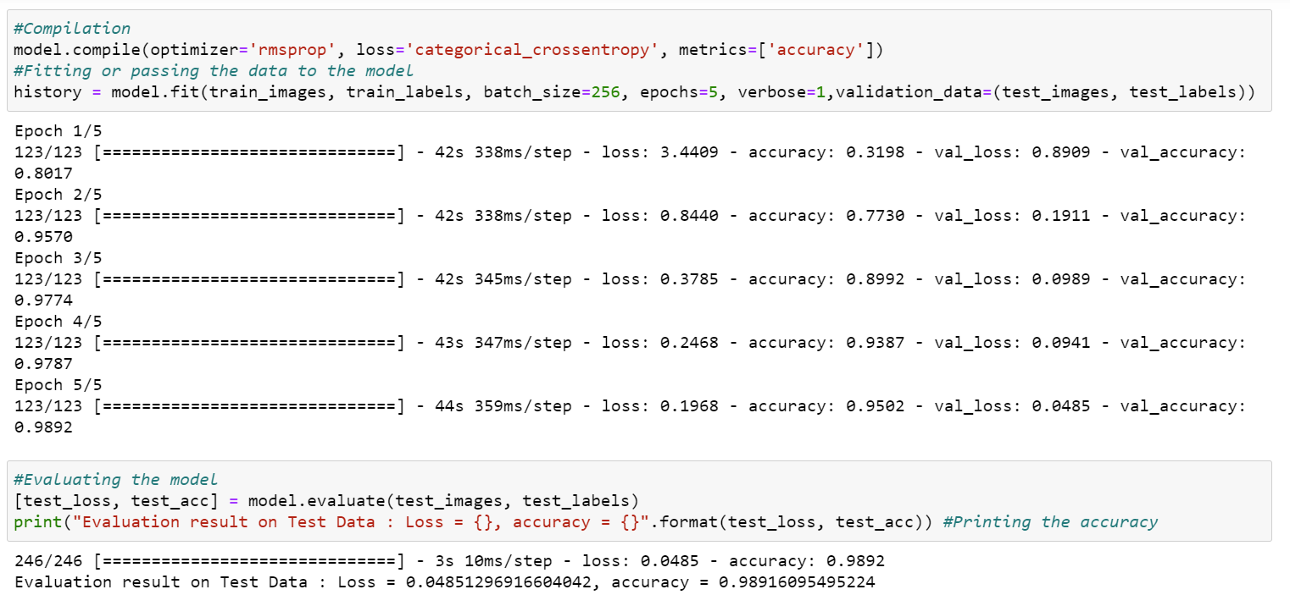
3. Building a CNN model and finding the accuracy.
Accuracy increased for the model from 95 to 98.9% and loss looks like same

Slide 14
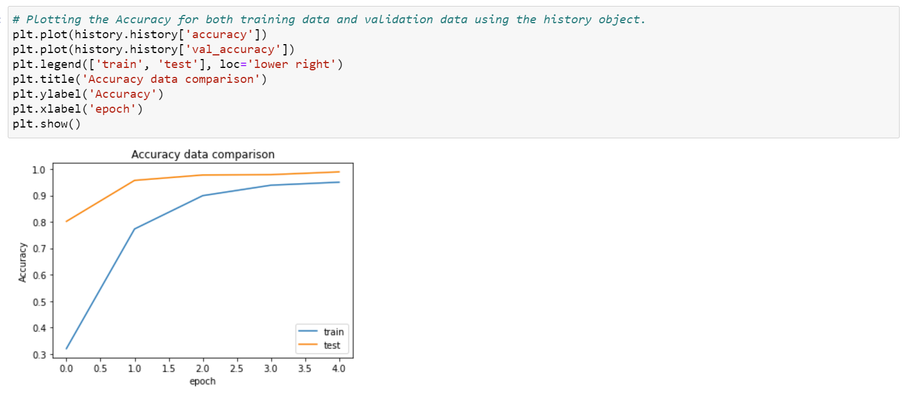
4. Accuracy and loss plots over train and test data
Accuracy :

Slide 15
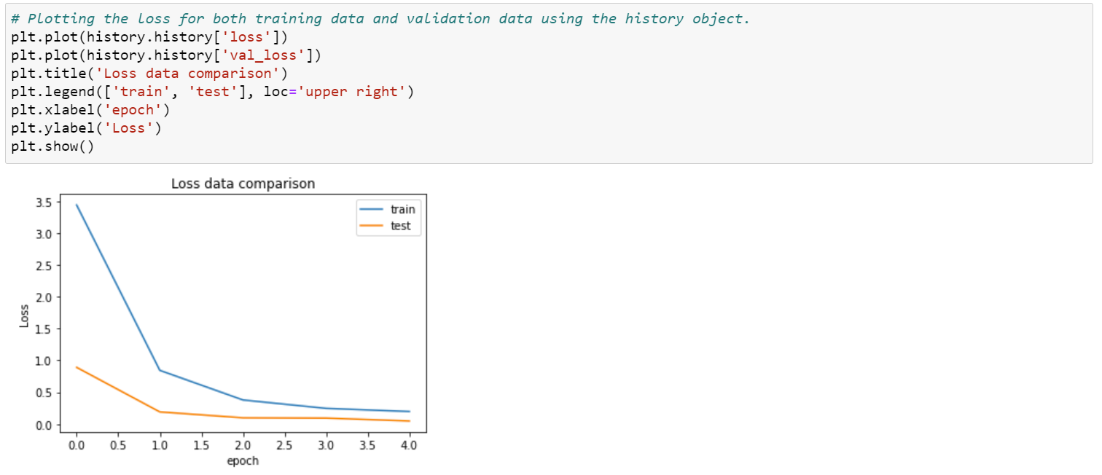
4. Accuracy and loss plots over train and test data
Loss :

Slide 16
5. Saving the model
model.save('traffic_sign_board_detector.h5')

Slide 17
Building a GUI by using above sequential model
Imported libraries for building GUI
Loaded the classes using CSV file
Created tkinter by following functions
1.Design
2.Prediction function
3.Display prediction
4.Upload an Image

Slide 18
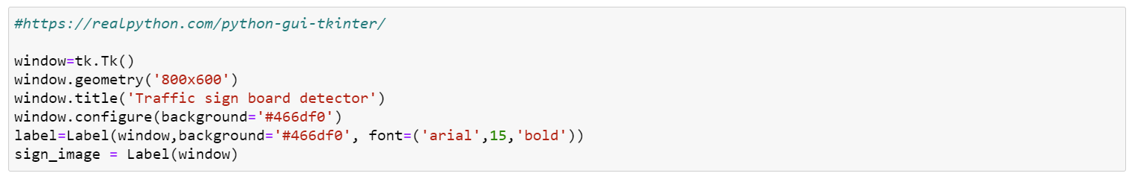
1.Design
Created a tkinter using below reference
https://realpython.com/python-gui-tkinter/
Geometrical dimension of 800*600
Done basic configuration

Slide 19
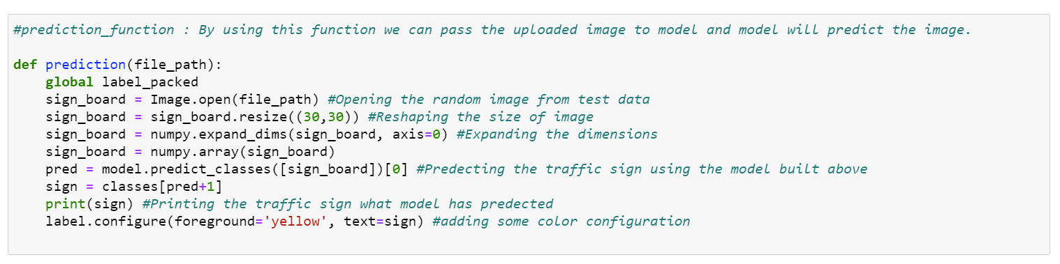
2. Prediction
This function will request the image from test data and will pass the image to the model and model will predict the image.
Done basic configuration for the predicted answer.

Slide 20
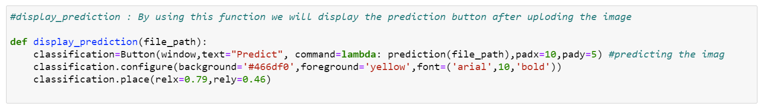
3. Display prediction
Display prediction function will display the prediction button after uploading the image and will prediction function is called.
Done basic configuration to the button

Slide 21
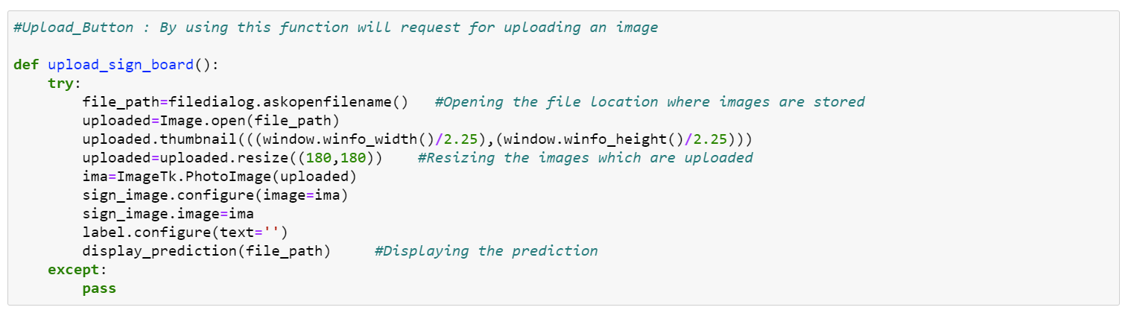
4. Upload an Image
By using upload_sign_board function , images are uploaded to the tkinter.
Done resizing of 180*180 for better display.
display_function is called after uploading an image.

Slide 22
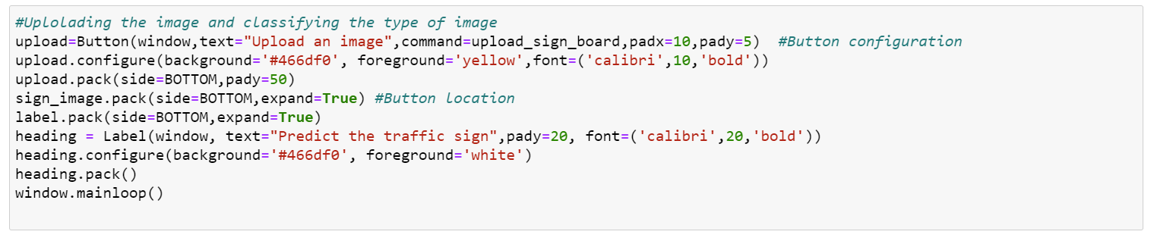
Upload button configuration was done.
Flow of the functions:
Upload an Image display prediction prediction

Slide 23
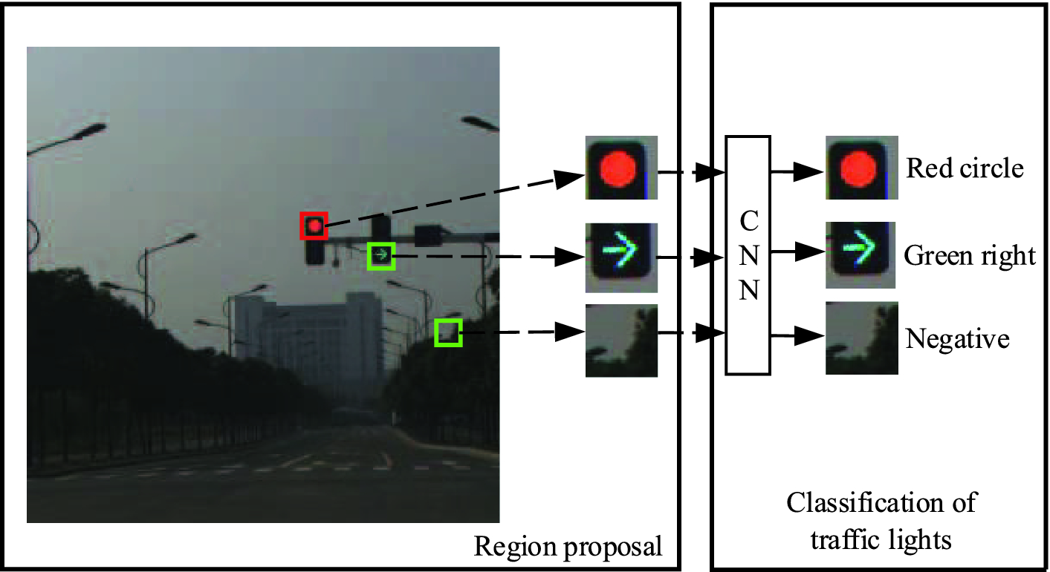
Results

Slide 24
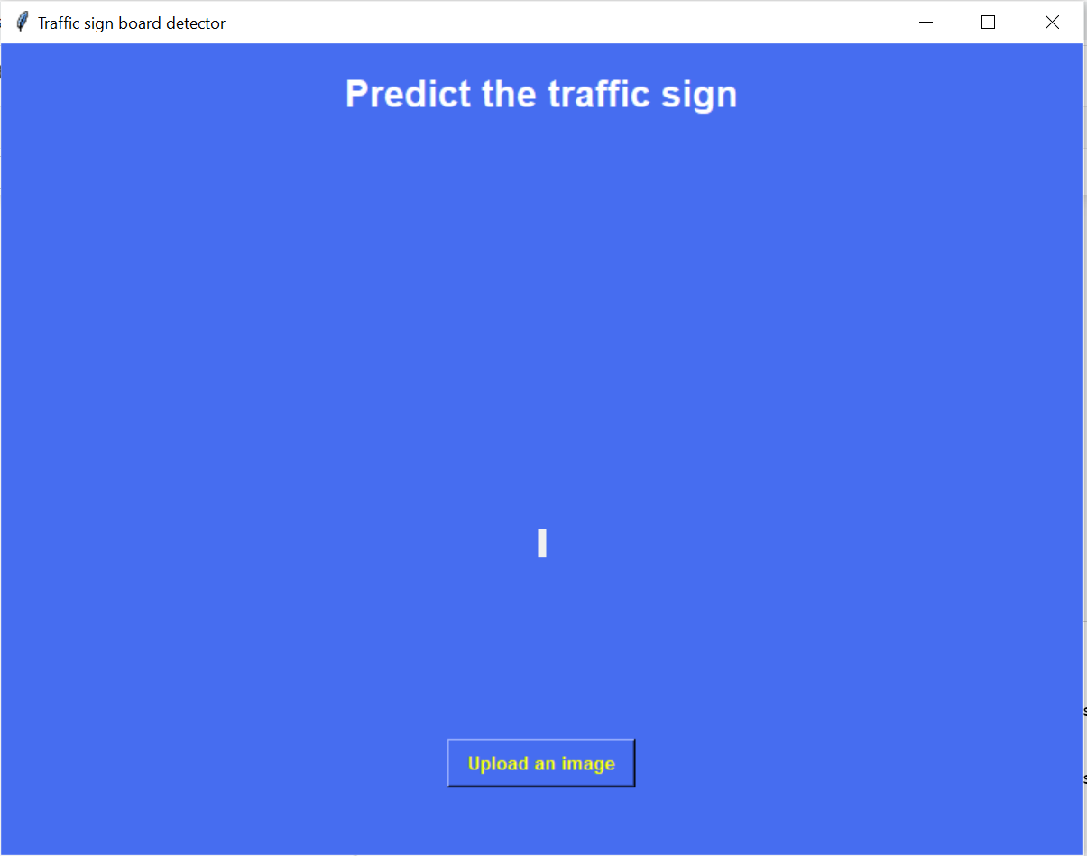
Results

Slide 25
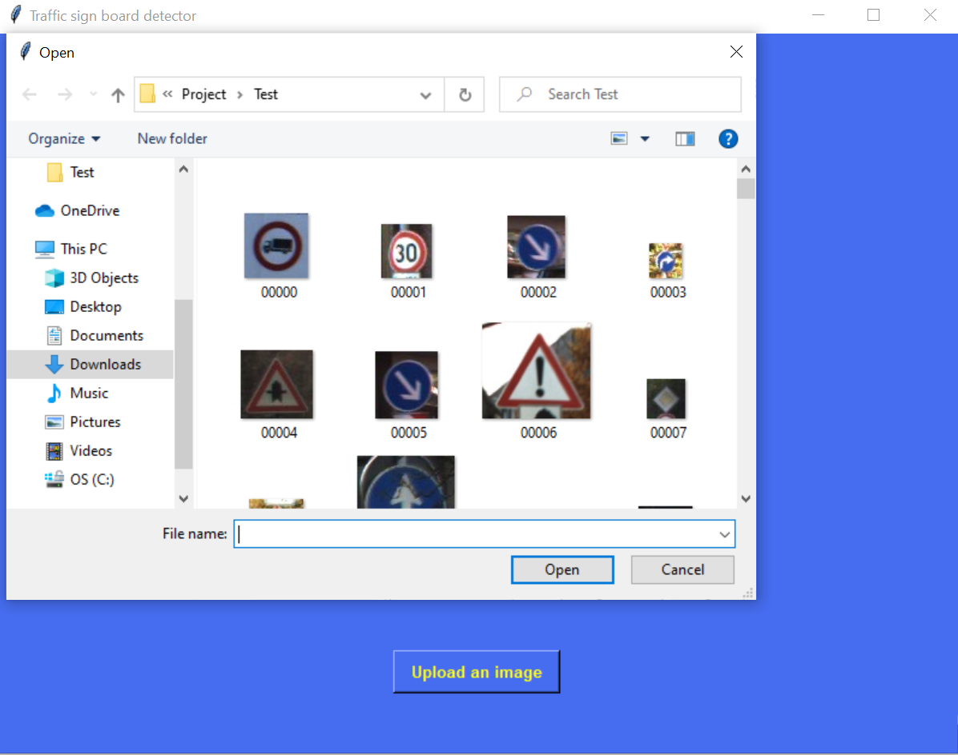
Results

Slide 26
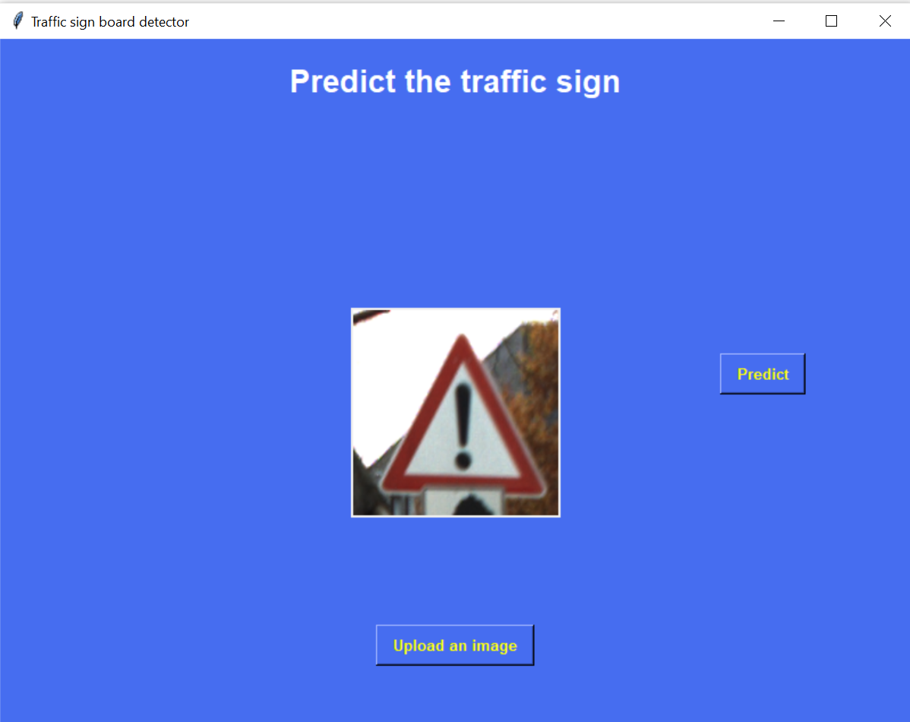
Results

Slide 27
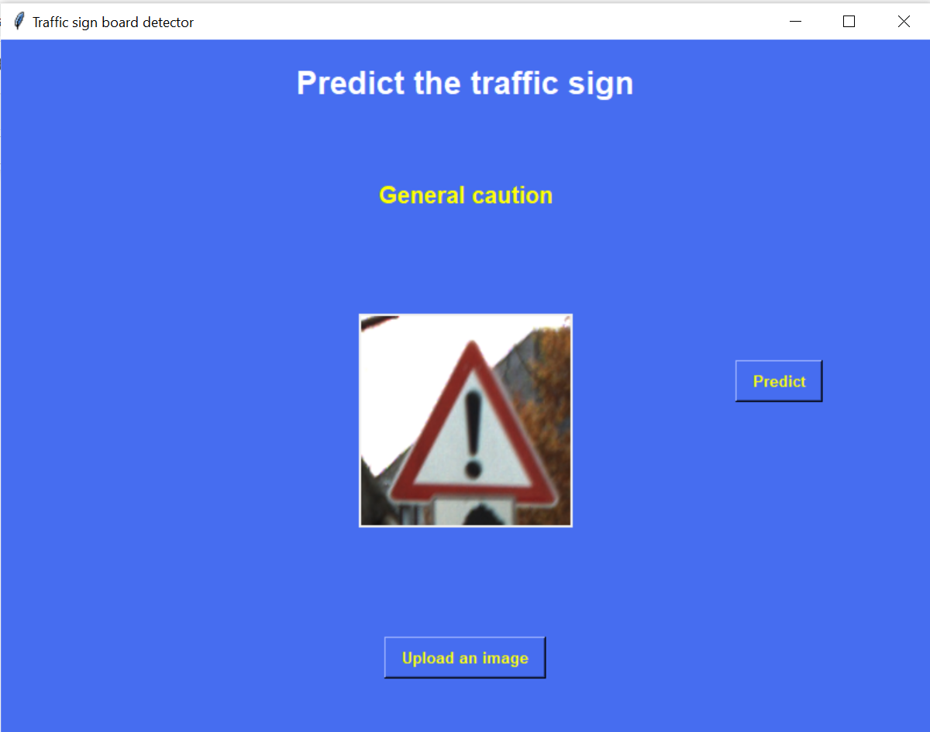
Results

Slide 28
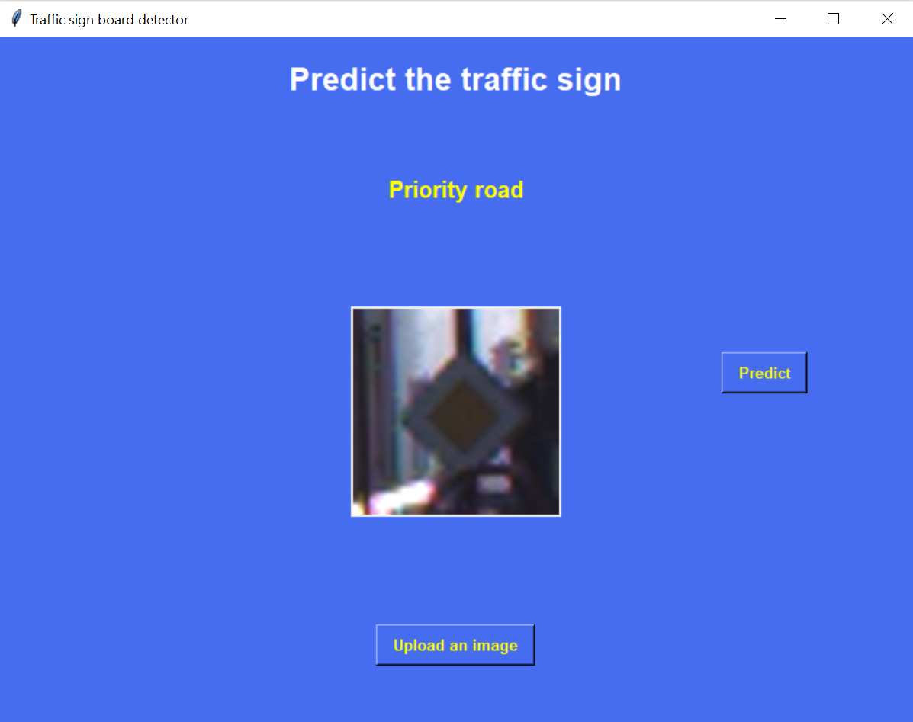
Results

Slide 29
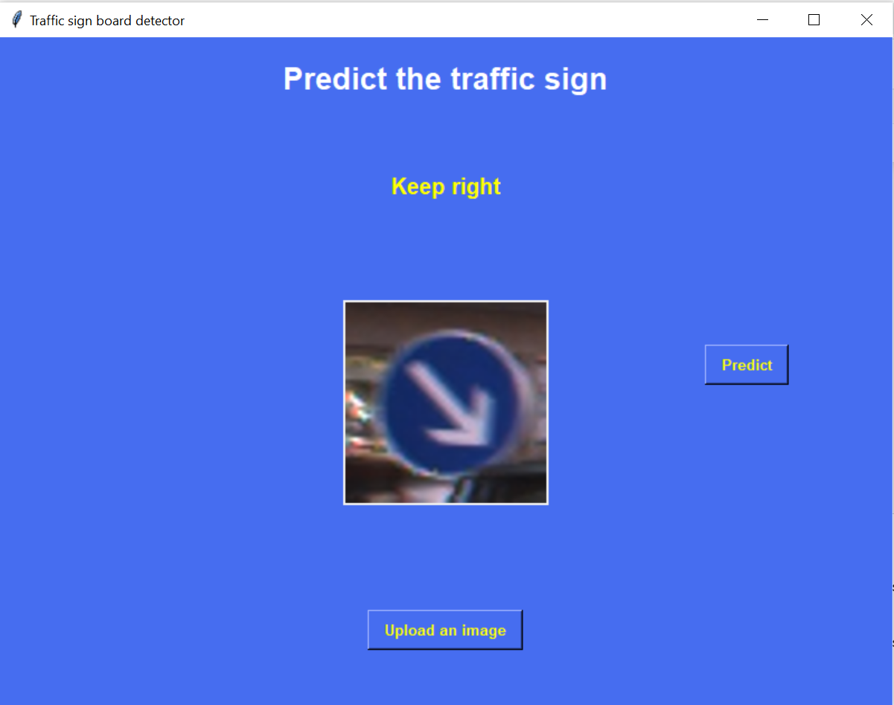
Results

Slide 30
Technologies Used
Python
Deep Learning

Slide 31
Future Scope
Can be used in self driving cars

Slide 32
Thank you

